Slide 1

Personal Data Project
Course: DATA211-50
Instructor: Wei Wei
Term: Spring 2022
Notes:
Slide 1:
Hello everyone. Here is the cover page of my project as my first slide. This slide states the name and number of the course, the name of the instructor, and the term of the course.

Slide 2
INTRODUCTION
My name is Mohamedeq Abdile
I have a 5-month-old daughter who is adorable and energetic
I am the first-born child in my family
Currently taking 12 credits this spring 2022 at Metropolitan University
My major is Mathematics (B.A), and this Summer 2022 will be my graduation semester
With the programming courses I took alongside my major, I am planning to work in an IT department once I graduated
Notes:
Slide 2:
First and for most, my name is Mohamedeq Abdile. I came to the United States five years ago. I am the first born of my family. I have a 5-month-old daughter who is amazing at times and annoying at times. I am the first born of my family. I am currently taking 12 credits this Spring 2022 at Metropolitan State University with my major being Bachelor of Arts in Mathematics. My graduation will be this coming summer 2022.
With the programming courses I took alongside my major, I am planning to work in an IT department in the coming months after graduation.

Slide 3
My_Activity_data Description
I have collected 14 data points about the time I spent in two activities, such as studying and gaming, for a random sample of 14 subjects for each activity. Each subject represents one day, so each activity is collected in 14 days. Use the significance level of 0.05 to test the claim that for the last 14 days, the average time spent studying was significantly less than the average time spent in gaming.
Question: Do I spend more time playing games than studying in my day-to-day activities or vice versa?
I will use R-Language to evaluate my findings of My_Activity_data in the upcoming slides.
Notes:
This slide portrays the main theme of my personal collected data name "My_Activity_data".
Read the data info:
I collected this data for 14 days mainly to see if I am spending more time in studying or in gaming and from there I can fix where I need to make good use of.
Ask a question: After I collected my data, the question I had in mind was, " Do I spend more time in playing games rather than studying?"
The next slide will give us my data that I collected for 14 days for each activity ; My two activities are 1. Gaming 2. Studying

Slide 4
My Personal Recorded Data
 | Activity | Time spent in hours for each activity
1 | Gaming | 5
2 | Gaming | 4
3 | Gaming | 5
4 | Gaming | 6
5 | Gaming | 3
6 | Gaming | 4
7 | Gaming | 5
8 | Gaming | 3
9 | Gaming | 4
10 | Gaming | 2
11 | Gaming | 3
12 | Gaming | 2
13 | Gaming | 3
14 | Gaming | 3
15 | Studying | 4
16 | Studying | 5
17 | Studying | 6
18 | Studying | 4
19 | Studying | 2
20 | Studying | 3
21 | Studying | 4
22 | Studying | 5
23 | Studying | 4
24 | Studying | 3
25 | Studying | 5
26 | Studying | 4
27 | Studying | 2
28 | Studying | 6
Notes:
Step 4:
Here is my data that I collected for 14 days. There is only activities I recorded namely; Gaming and Studying.
Each activity has 14 data points that means my sample is 14 (n=14)
On the right side denotes the number of hours I spend in each activity

Slide 5
My_Activity_data ( R-Input)
library(tidyverse)
library(ggplot2)
#Step 1: Formulate the null and alternative hypotheses
H0:mu_studying = mu_gaming Ha:mu_studying < mu_gaming
#Step 2: Two-Sample- Because I am comparing two population means
Independent T-test (1-sided)-Compare two totally different populations (studying to gaming)
#Step 3: Find the t- statistic and p-value
t.test(Time_Spent_hours~Activity, data=My_Activity_data, alterantive="greater")
Notes:
Step 5:
So, I translated my personal data into R-coding.
I formulated my null my data: Stating that the average time for studying is always equal to the average time for gaming.
My alternative hypothesis: Stating that the average time I spent in studying is less than the average time I spent in studying
In step 2: because I am comparing two different population means, I will specify that I am going to use two-sample test especially an Independent T-test (1-sided)
In Step 3: I chose T-test because I am dealing with population means. My data is designed in a way that I have an independent variable on the left (gaming and studying) and Dependent variable on the right (hours spent in each activity).
I also chose my data name " My_Activity_data" and I put "greater" in the alternative section because gaming comes before studying.

Slide 6
My_Activity_data ( R-Input) Graphing
Step 4: Means with error bar graph
My_Activity_data%>%
group_by(Activity)%>%
summarize(Average_Time=mean(Time_Spent_hours),seTime=sd(Time_Spent_hours)/sqrt(length(Time_Spent_hours)), tstar=qt(1-0.05/2,length(Time_Spent_hours)-1))%>%
ggplot(aes(x=Activity,y=Average_Time))+geom_point(color="brown")+geom_errorbar(aes(ymin=Average_Time-seTime*tstar,ymax=Average_Time+seTime*tstar), color="blue")+labs(title = "Average time spent on sleeping and studying")

Slide 7
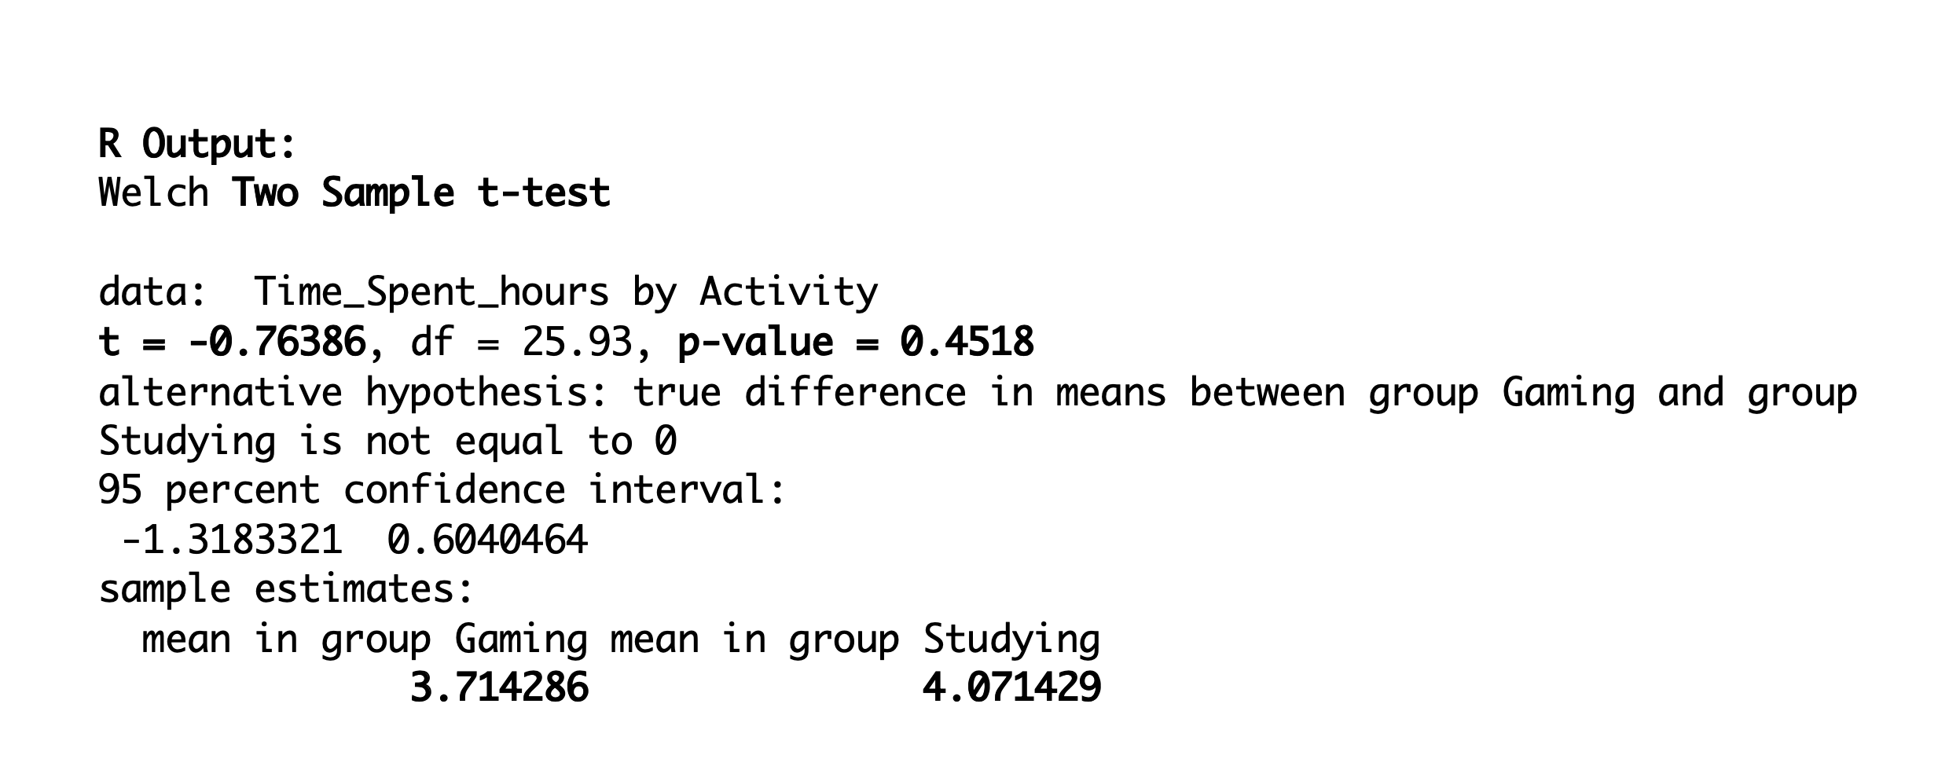
Output in R

Slide 8
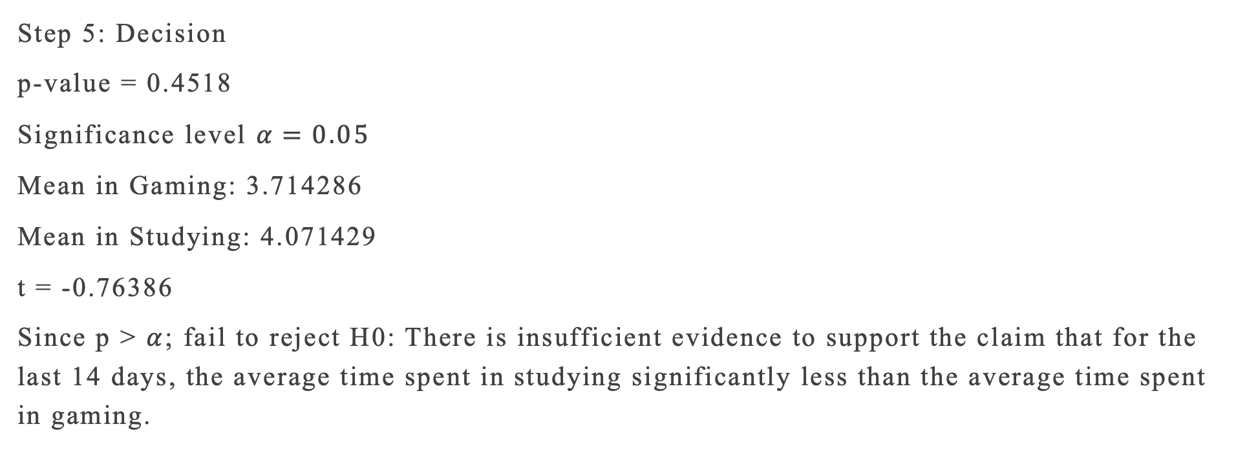
DECISION
Step 5: Decision
p-value = 0.4518
Significance level $α=0.05$
Mean in Gaming: 3.714286
Mean in Studying: 4.071429
t = -0.76386
Since p > $α$; fail to reject H0: There is insufficient evidence to support the claim that for the last 14 days, the average time spent in studying significantly less than the average time spent in gaming.

Slide 9
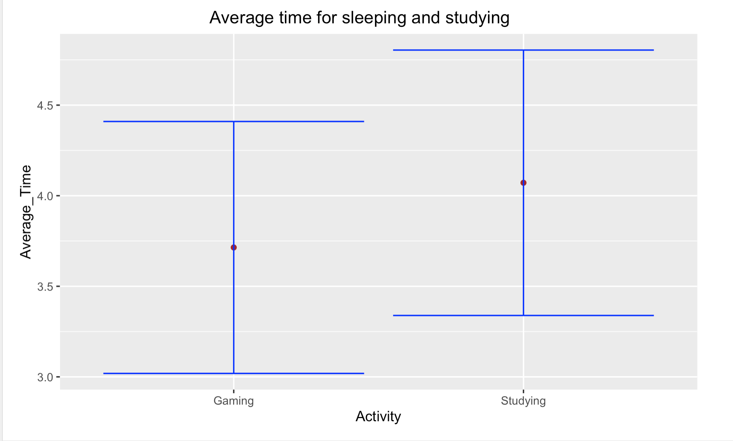
Means with error bar graph
The graph on the left side shows that the average time I spent in studying for 14 days is significantly higher than the average time I spent in playing games (gaming).

Slide 10
Graph cont.
The graph shows the opposite of my claim which states that I spent significantly less time in studying than gaming.
The CI from one group does NOT include the mean from the other group hence there is significant difference between the two activities (Gaming and Studying respectively).

Slide 11


Question

